Slide 1




Enakl Transportation App

Slide 2







OUR TEAM
Amr Amin
Gamal Eldin Mahmoud
Omar Emad
Mohamed Hamdy
Mahmoud Abdelfatah
Under Supervision of
Eng. Amira Yahia Shahen

Slide 3


Presentation Content
Data Set Brief
1
Conclusion
6
2
Data Cleaning Process
Buisness Reccomendation
Data Preparation for Power BI
5
3
4
Power BI Dashboard Recommendation

Slide 4



Data Analysis Steps
Data Checking
Asking Questions
Data Correction
Data Cleaning
Data Visualization
Data Verification and Business Recommendations

Slide 5

Dataset Brief

Slide 6
Data Set Brief
Category | Data Point
ide Details | Ride Date
Ride Details | Bus Line Name
Ride Details | Driver's Name
Ride Details | Driver's Rating
Ride Details | Service Rating
Financial Information | Initial Fare
Financial Information | Payment Method
Financial Information | Discount Code
Address Details | Origin Address
Address Details | Destination Address
Address Details | Pickup Address
Address Details | Drop-off Address
Category | Data Point
Booking Information | Booking ID
Booking Information | Pickup Location
Booking Information | Drop-off Location
Booking Information | Passenger Count
Booking Information | Booking Status
Booking Information | Cancellation Date
User Information | User ID
User Information | Registration Date
User Information | Anonymization Status

Slide 7



Questions to be answered

Slide 8
How does the payment mode distribution vary by ride date or booking source?
What is the average fare per payment method?
What are the average ratings for drivers and services?
How do different drivers' ratings compare?
What are the common reasons for ride cancellations?
What are the most common pickup and drop-off locations?
The highest driver rating
How many bookings were made over time?
What is the distribution of bookings by source (e.g., App, Call Center)?
What is the trend of bookings across different bus lines?
What are the most common payment methods (Credit, Zero, CB)?

Slide 9

Total Bookings: The total number of bookings within a specified time frame.
Bookings by Source: A breakdown of bookings by their origin (e.g., App, Call Center).
Bookings Over Time: A line chart showing the number of bookings per day or month to visualize trends.
Payment Methods Distribution: A pie or bar chart showing the proportion of each payment method (Credit, Zero, CB).
Revenue by Payment Method: Total revenue generated per payment method, calculated by summing the initial fares.
Average Driver Ratings: A bar chart displaying average ratings for each driver.
Service Ratings: Aggregated service ratings to assess overall customer satisfaction.
Cancellation Reasons: Analysis of booking cancellations, including reasons and cancellation dates.
Impact on Revenue: How cancellations affected the revenue, particularly comparing confirmed vs. canceled rides.

Slide 10
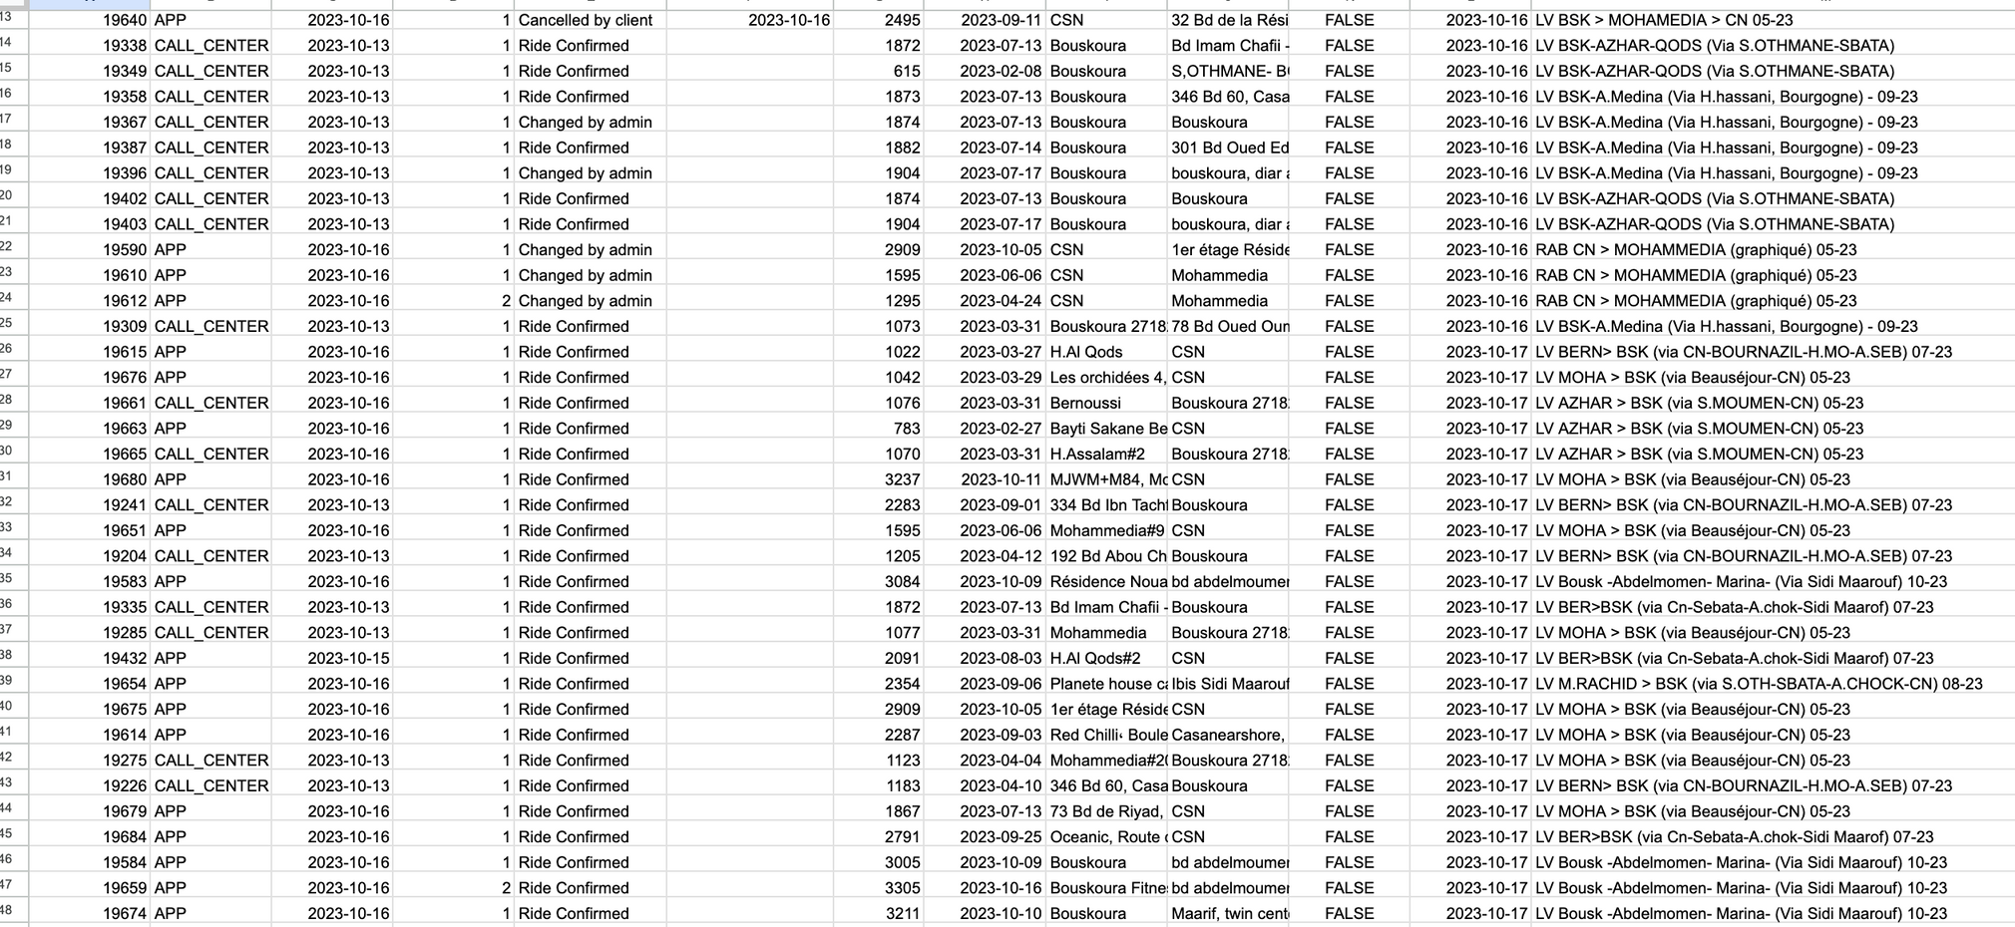
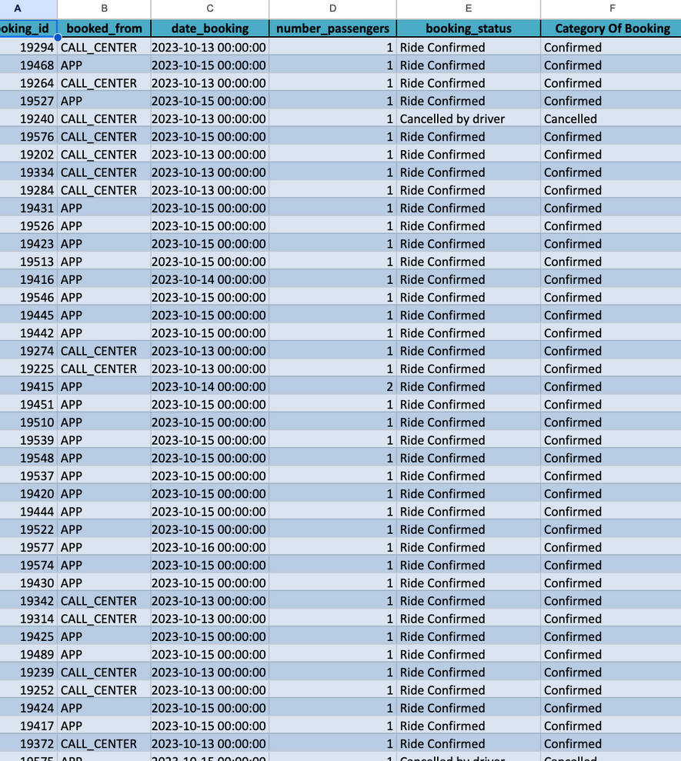
Before
After

Slide 11

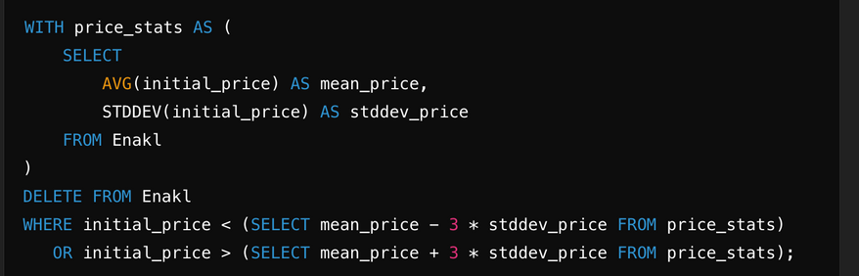

Software Used
Dax and data modeling
SQL Queires
Excel

Slide 12


Tables building and relation correction
Correct Nulls
Remove outliers

Slide 13
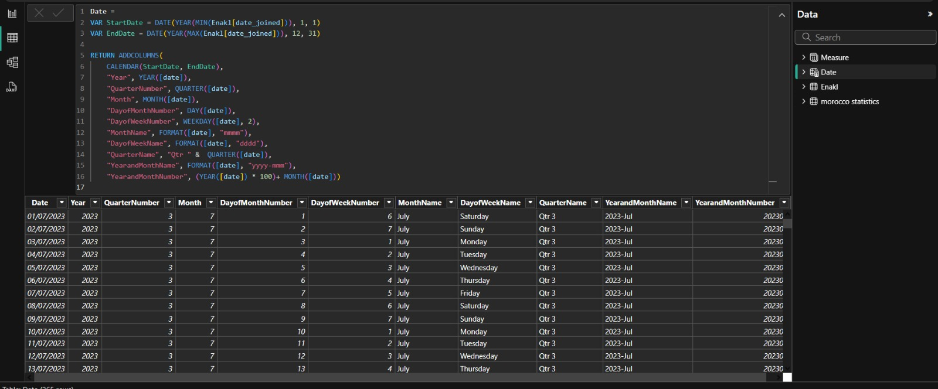
Time Intelligent

Slide 14
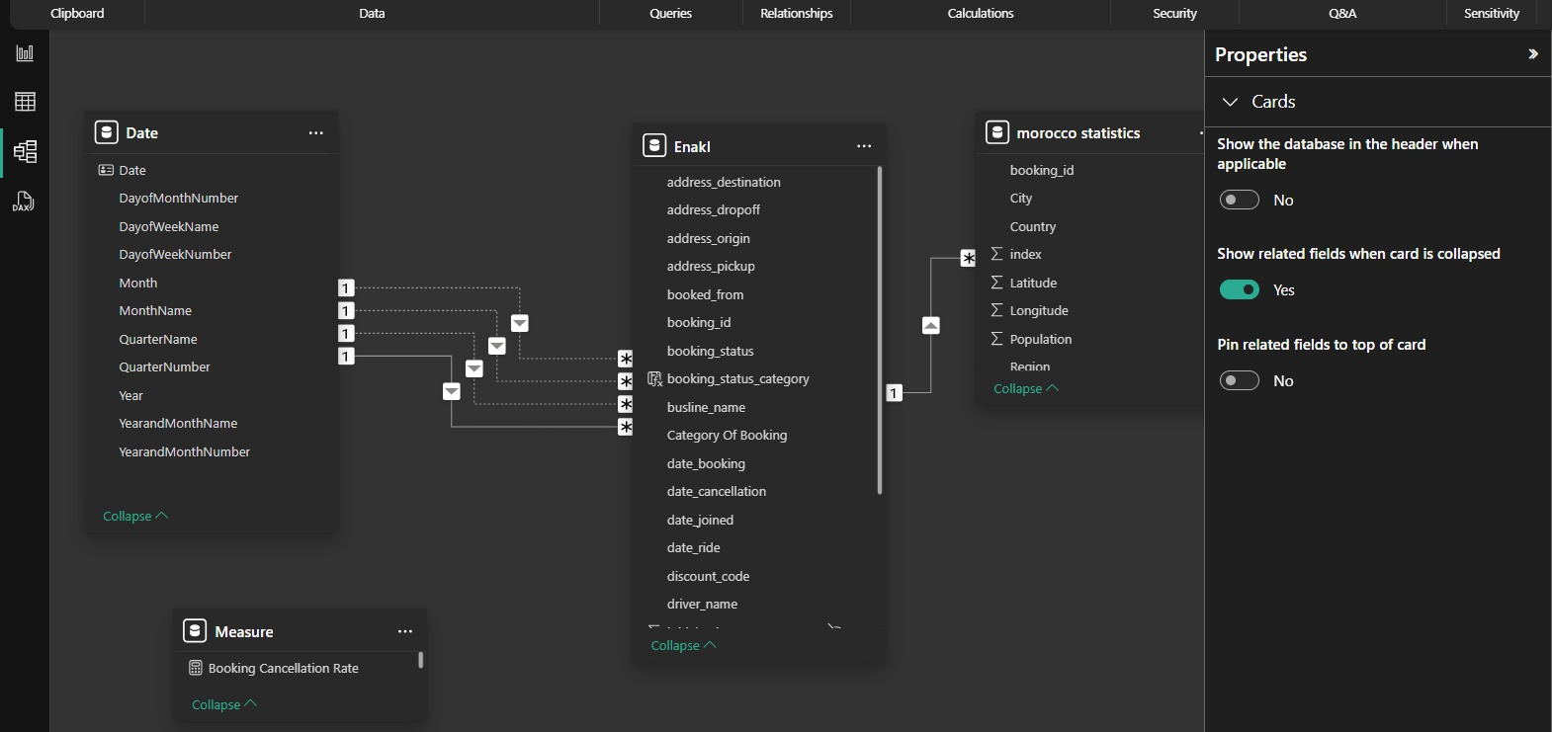
Data Modeling

Slide 15
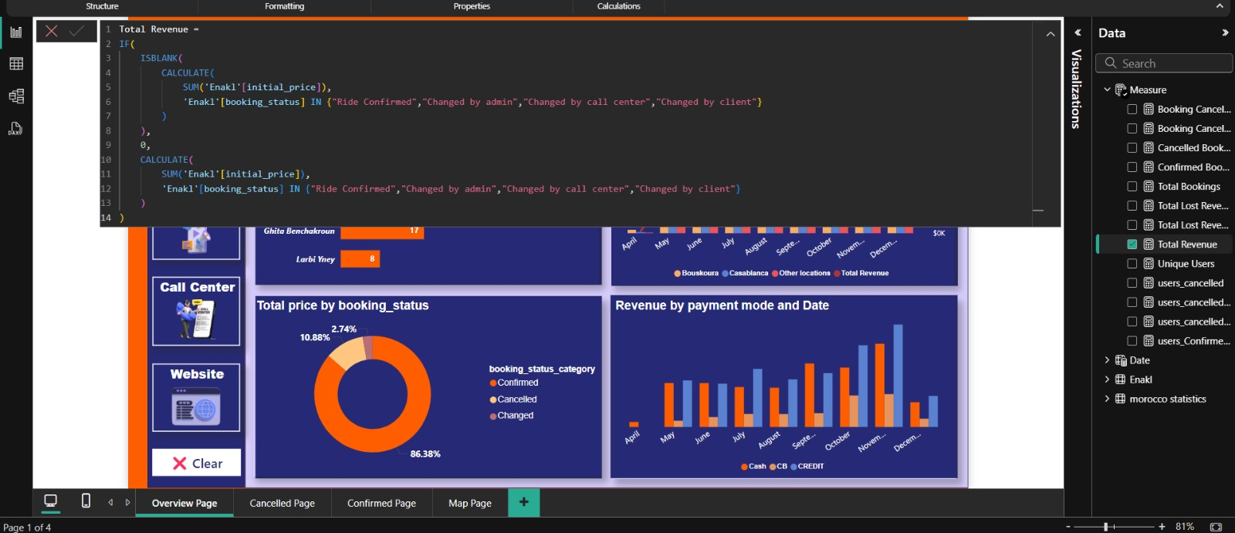
DAX - Screens

Slide 16
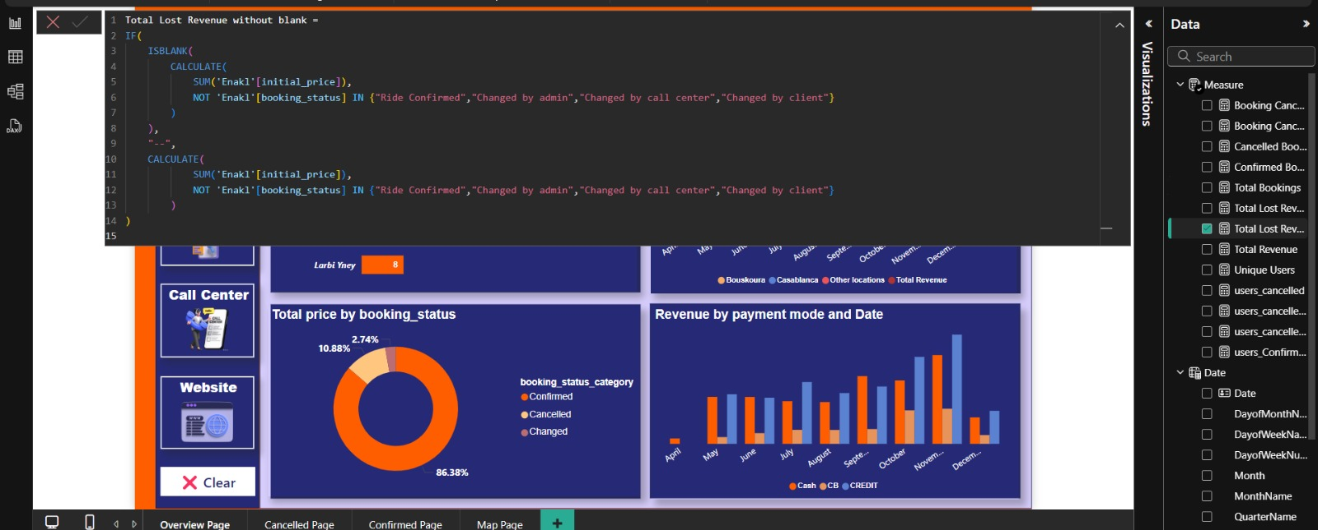
DAX - Screens

Slide 17
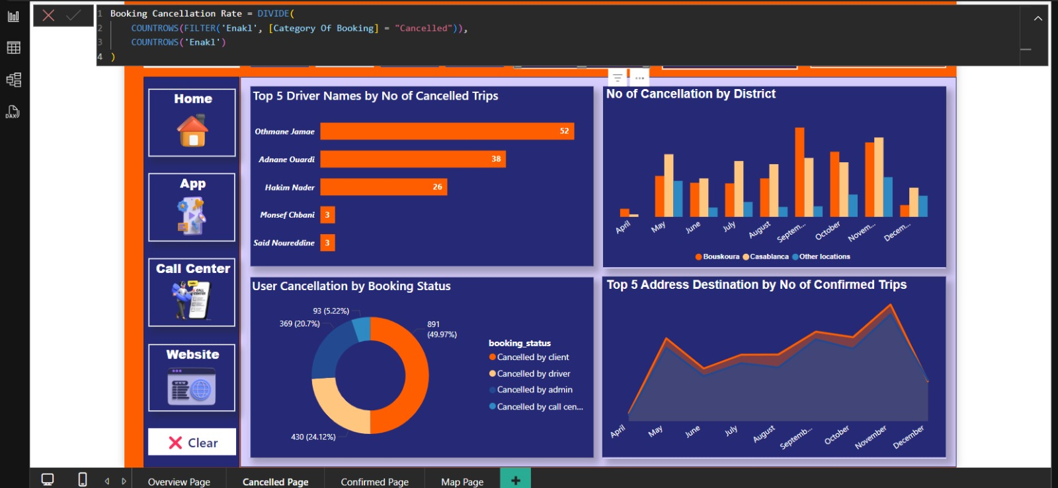
DAX - Screens

Slide 18
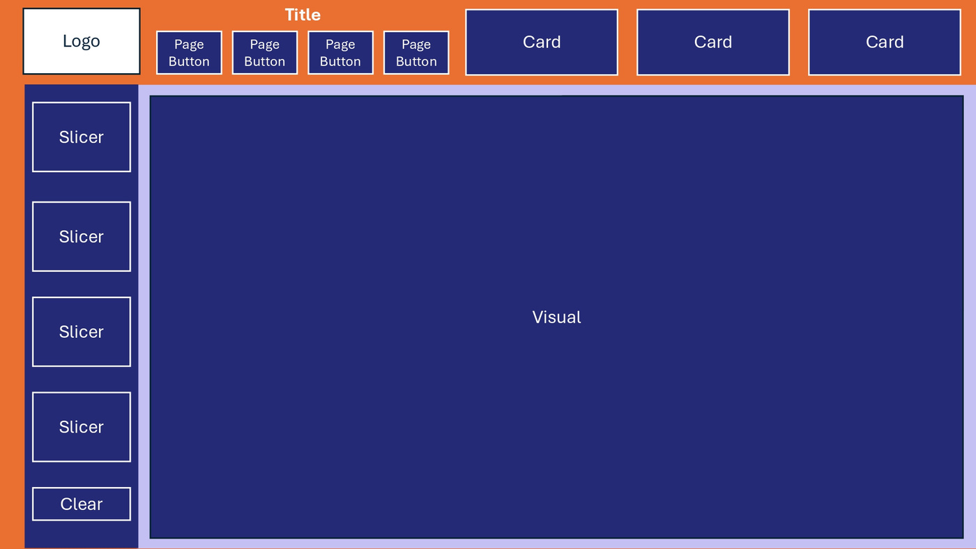

Dashboard Drafts

Slide 19
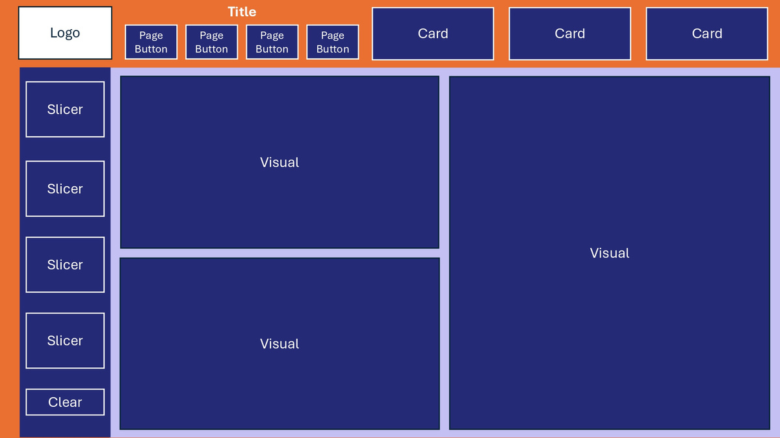
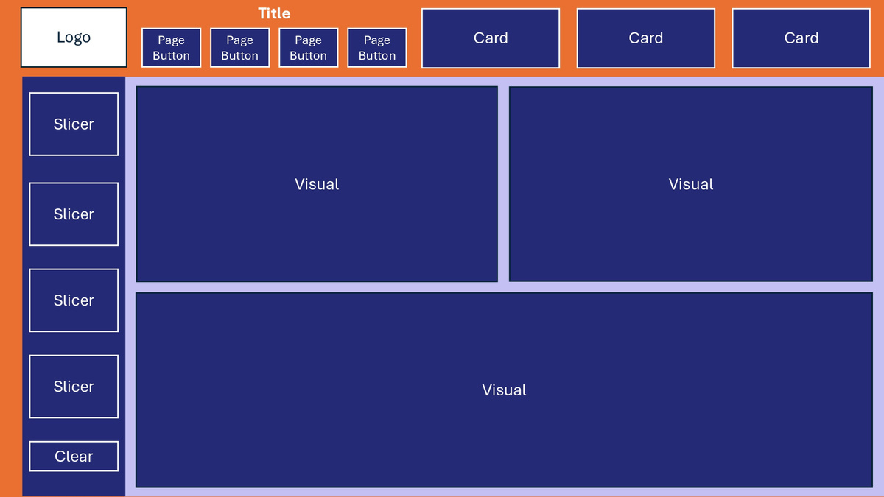
Dashboard Drafts
Option 2
Option 3

Slide 20
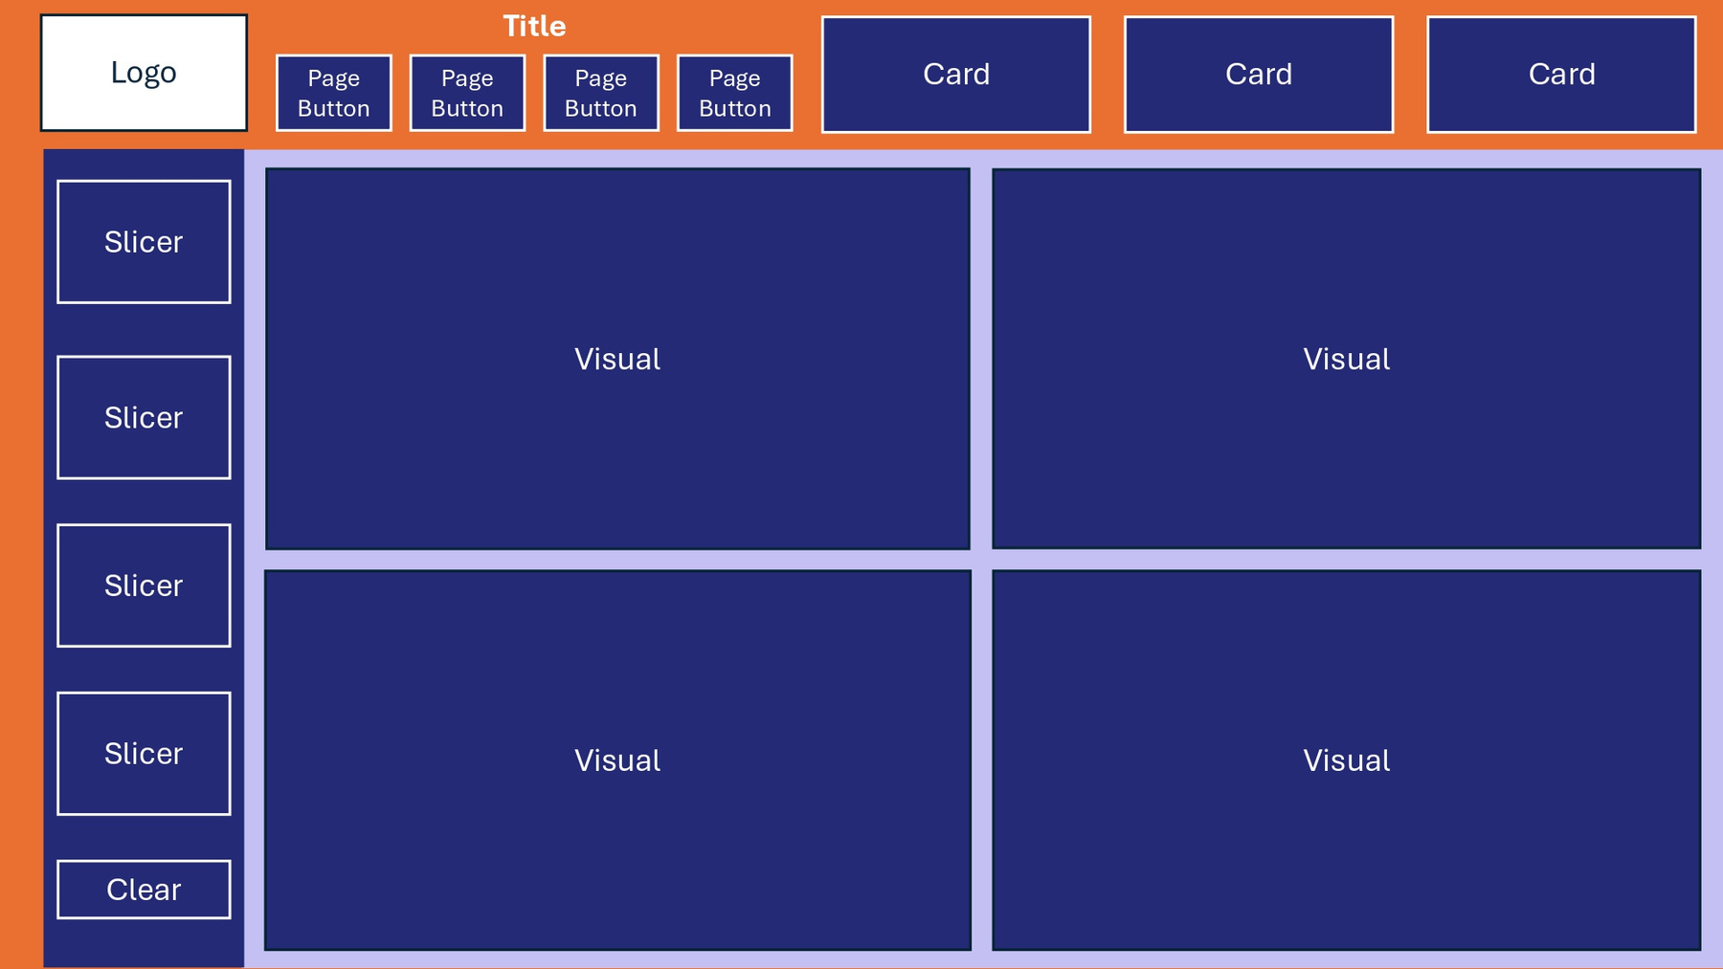
Dashboard Final Option
Final Option

Slide 21
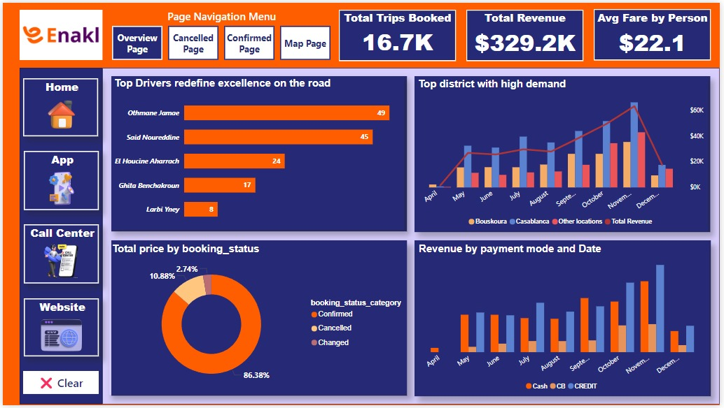
Dashboard Overview

Slide 22
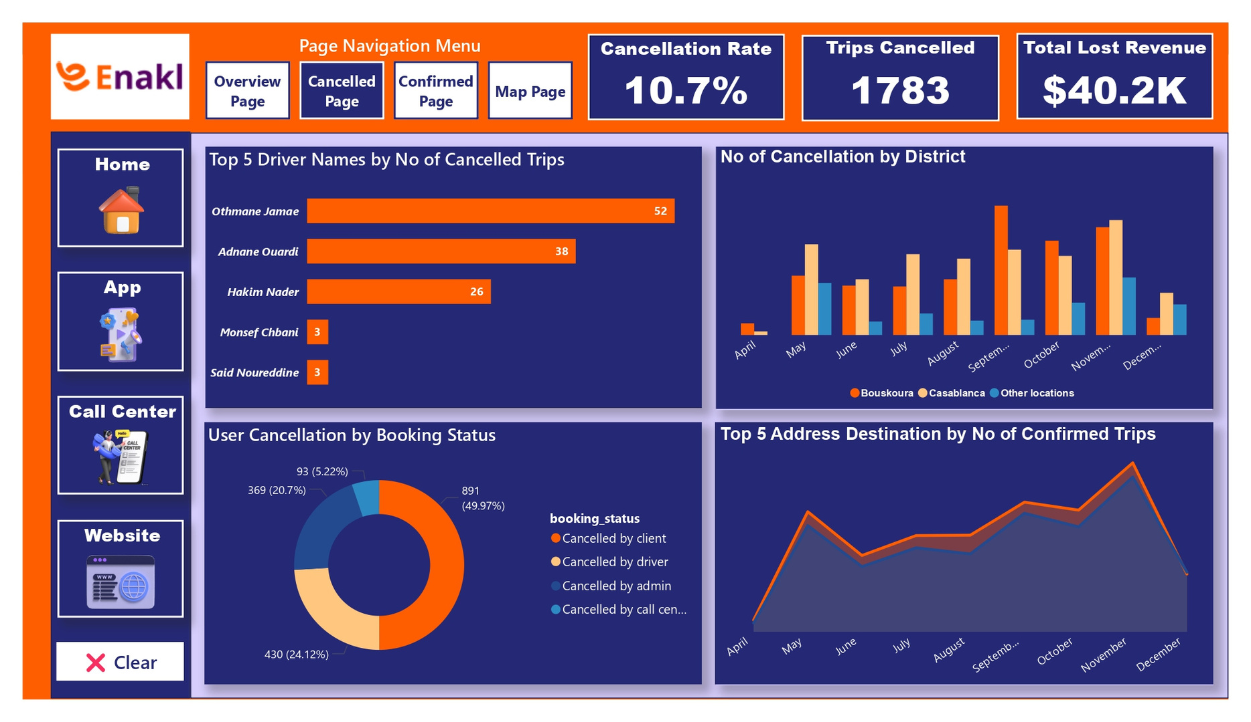
Dashboard Overview

Slide 23
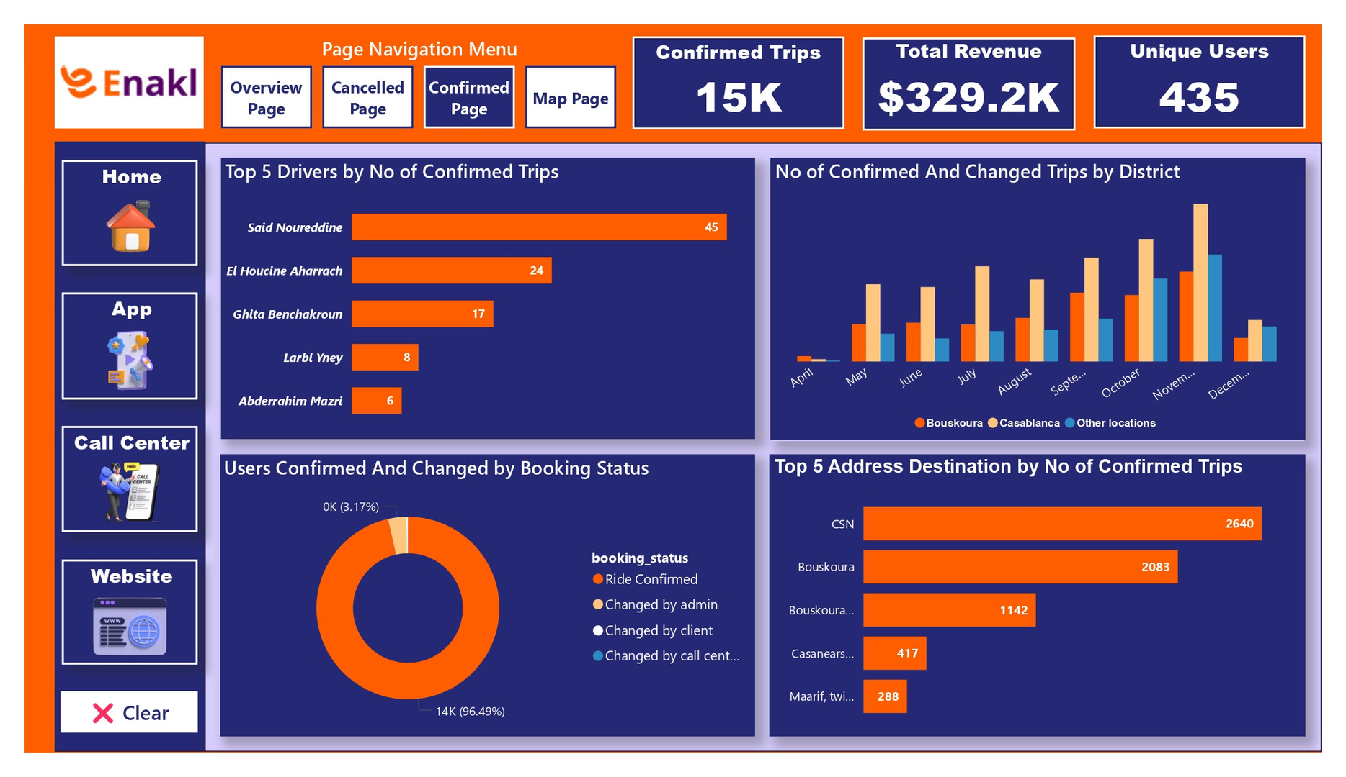
Dashboard Overview

Slide 24
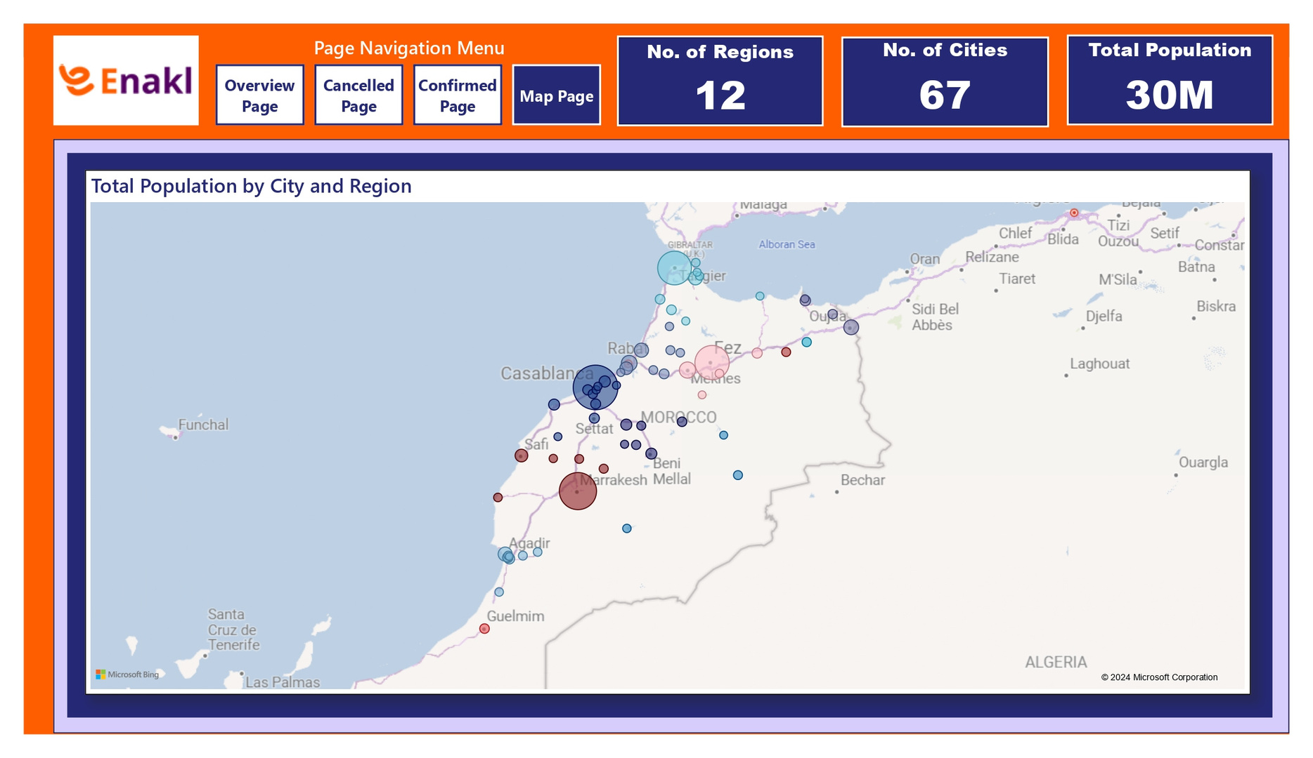
Dashboard Overview

Slide 25
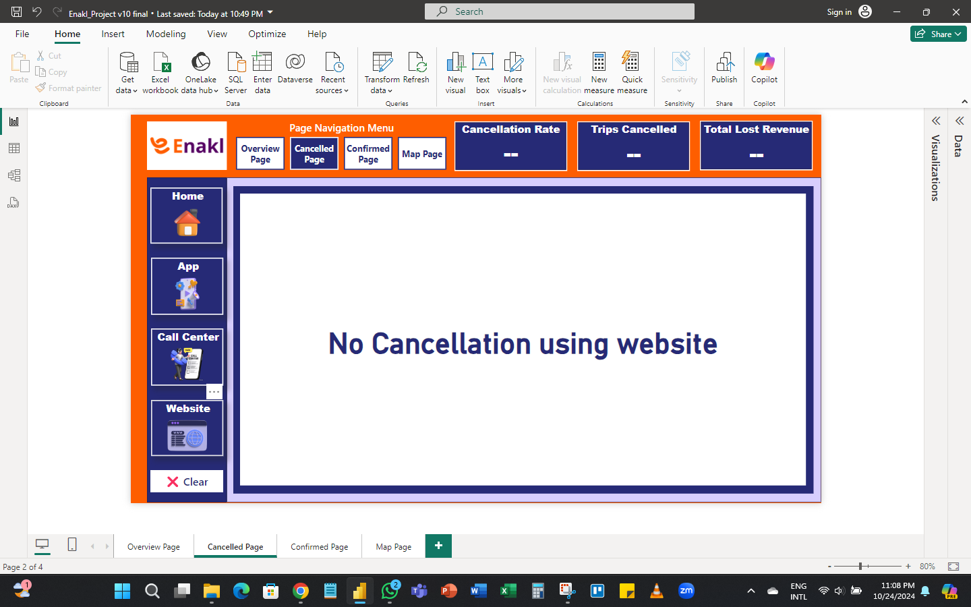
Dashboard Overview

Slide 26
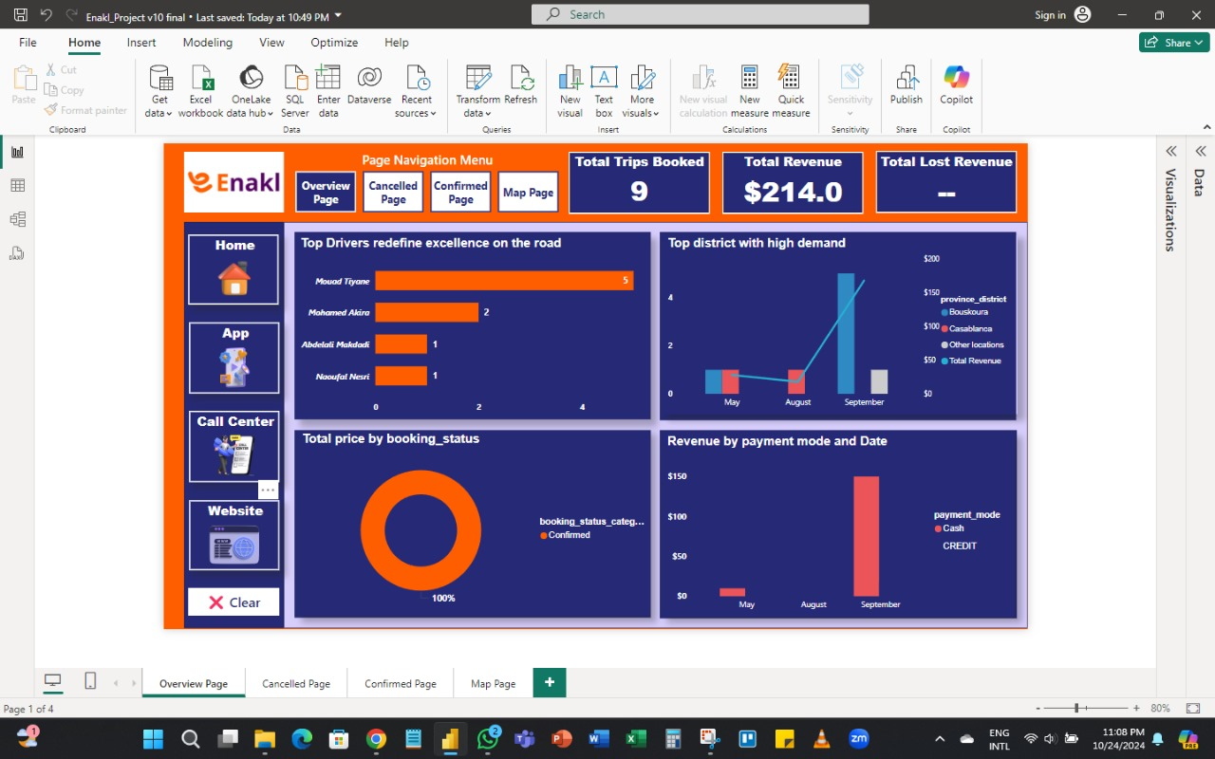
Low Website Orders

Slide 27


Business Reccomendations

Slide 28




Business Reccomendations

Slide 29

Website Enhancement

Slide 30
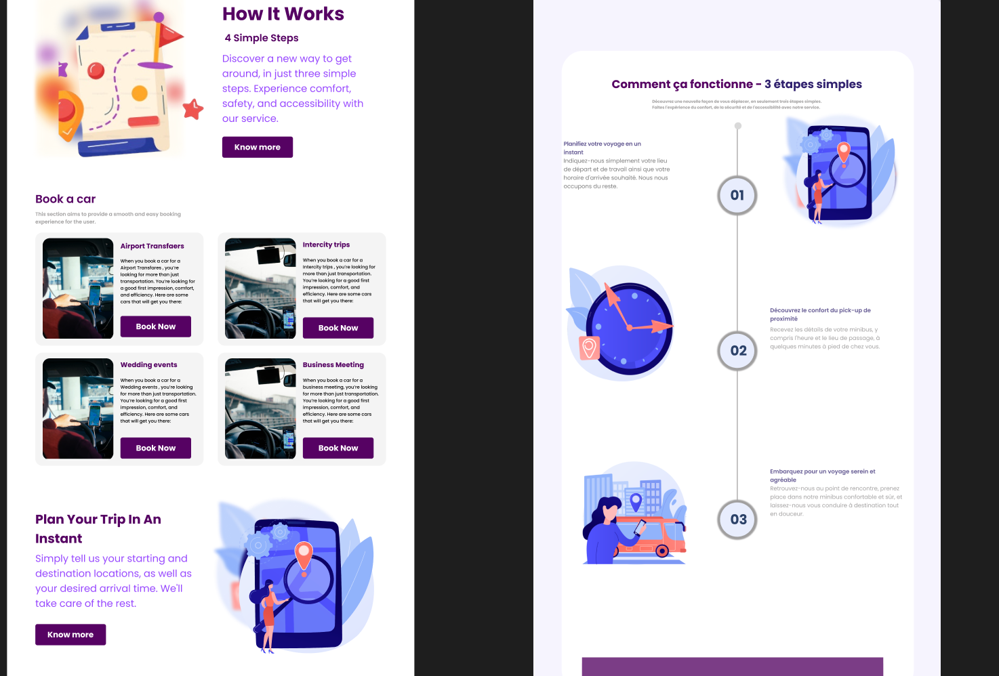
Before
After

Slide 31
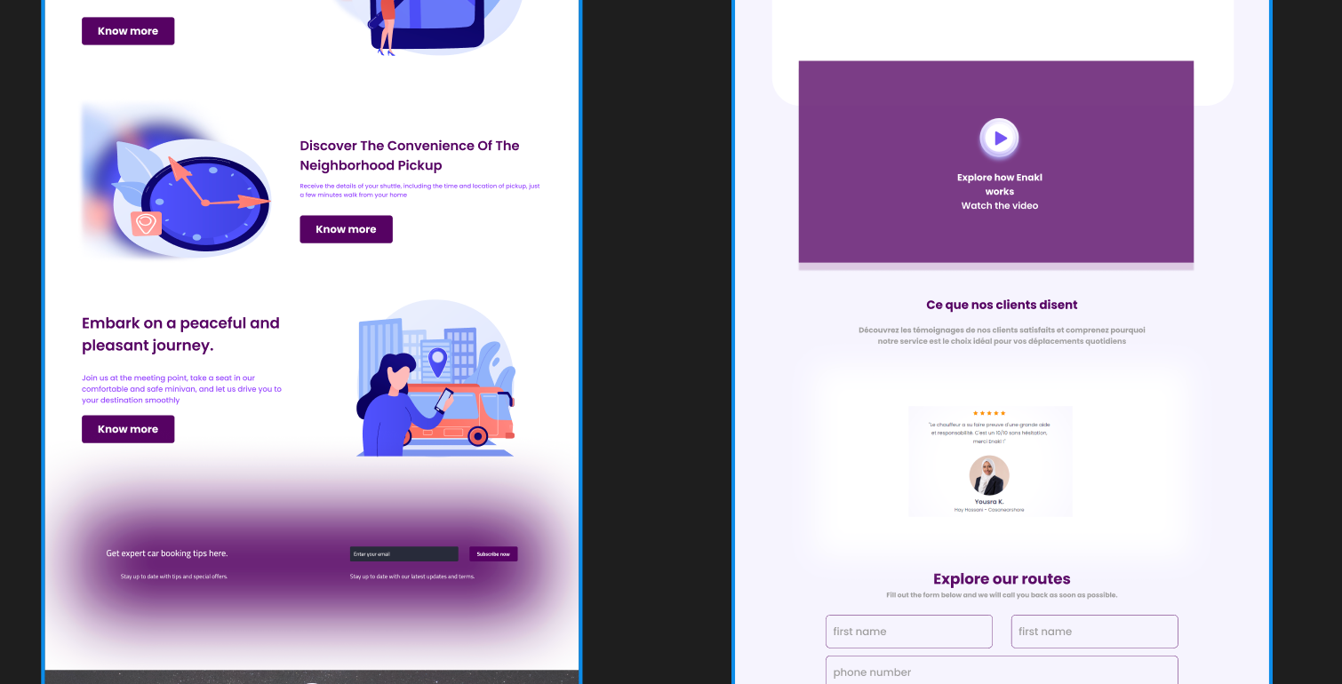
Before
After

Slide 32


Payment Methods

Slide 33



Marketing Reccommendations
Targeted Social Media Campaigns
SEO Optimization
Referral Programs

Slide 34
Enakl Transportation App
THANK YOU

